Slide 1
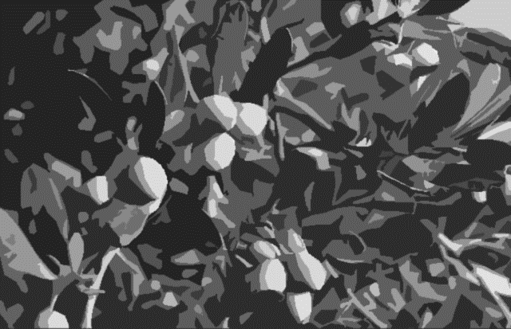
Family ties
The Remaining Inheritances.
Joshua 14 – 19 Part 2.
(YAH 6/07/20)
…and there remaineth yet very much land to be possessed. Joshua 13:2b

Slide 2
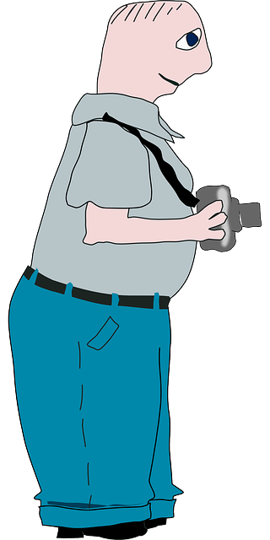
Our Tour Plans for Today
Tour the remaining inheritances.
Take a few snapshots along the road.
Stop off at the Cities of Refuge
End our Journey at the Levitical cities.
Most of our applications this week will be en route and very much to the point.

Slide 3
Where we’ve been
Manasseh
East
13-14
Gad
13-14
Reuben
13-14
Judah
15
We have finished “East River”
We were working on Judah…
The Lands Inherited Directly from God

Slide 4
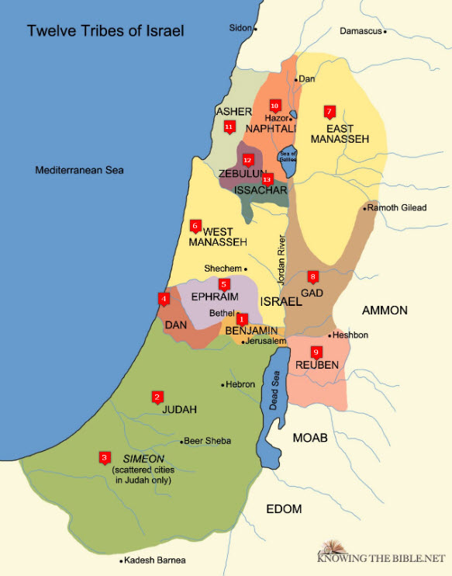
No time to review Judah, so just keep in mind:
1. Judah is the big factor in southern Israeli history. She is greatly surrounded by enemies and will have much warfare in her future.
2. Caleb’s inheritance is within Judah. He requests and is granted Hebron. We could devote a lesson to the role of Hebron in history and the spiritual significance of Caleb’s choice. Caleb aligned himself with his spiritual roots.
3. Caleb “wholly followed the God of Israel.” He is a breath of fresh air in contrast to his tribal counterpart, Achan.
Caleb is a reminder that we can stand courageously strong and true despite the carnality of believers and wickedness of the world. Achan lost himself and his family while,
4. Caleb protected his family. Caleb passed his zeal and initiative down to his family!
Judah failed to drive out the Jebusites, the inhabitants
of Jerusalem.

Slide 5
Where we’ve been
Manasseh
East
13-14
Gad
13-14
Reuben
13-14
Judah
15
We have finished “East River”
Ephraim
16-17
Manasseh
West
16-17
Benjamin
18
Simeon
19:1-9
Zebulun
19:10-16
We spent time with Judah.
Today’s map
Asher
19:24-31
Naphtali
19:32-39
We will now mention the last tribes briefly, limiting our comments to a few important truths.
Issachar
19:17-23
Dan
19:40-48
The Lands Inherited Directly from God

Slide 6
Ephraim
Joshua 16, 17
Genesis 48:19,22
Notice that, here in Joshua, we are adding another chapter of the story that began in Genesis with Jacob’s blessings for his sons.
Jacob’s selection of Ephraim as the firstborn had caught Joseph off guard. Though Manasseh would surely become great, Ephraim would become so influential that it was often equated with the ten northern tribes of Israel.
“In verse 22 we see that Joseph, through his two sons, is to have a greater inheritance than the other brothers would have.” McGee
Ephraim failed to drive out the Canaanites,
but placed them under tribute. 16:10

Slide 7
Manasseh
Genesis 48:5, Joshua 17:14-18.
This instructor feels that Ephraim and Manasseh felt entitled because of the special treatment they received as Jacob’s favored Egyptian born grandsons. (Opinions vary.)
Joshua respects the divine blessings of Jacob (as should we) but does not give way to the requests for a special allotment. God is not a respecter of privilege or persons.
While our spiritual lots, areas of influence,
our challenges, and our hopes vary,
our God treats us all equally and equitably.
None are privileged and none are under valuated.
Note: Manasseh failed to drive out the Canaanites,
but placed them under tribute. 17:13

Slide 8
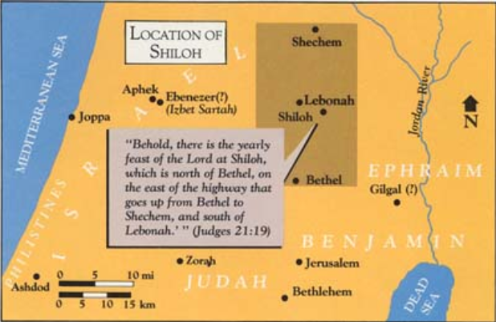
Some Drive-By Snapshots
Chapter 18:a
Verse 1 - Moving the tabernacle from their base camp in Gilgal to Shiloh makes it more central and accessible to all.
Remember, temples are not essential to our worship, but corporate worship is never optional. It essential to all of God’s people in all times!
The tabernacle has been moved from Gilgal to Shiloh
Am I failing to possess what God has for me?

Slide 9
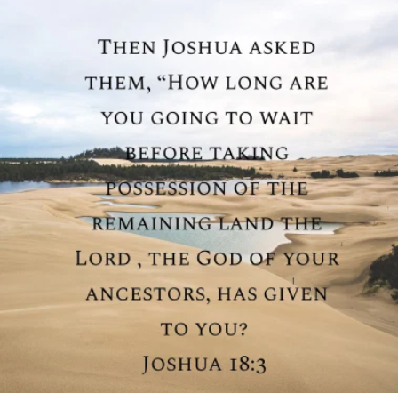
Some Drive-By Snapshots
Chapter 18:a
Verses 2-6 A kickstart for the remaining seven tribes who were showing up late to work.
Men from each tribe were to “rise”,” go through the land”, and “describe it.”
It is the duty of our spiritual leaders to admonish us concerning our unfinished tasks.
It is our personal duty to prayerfully ponder our own spiritual inheritances and to possess what God has for us.
The tabernacle has been moved from Gilgal to Shiloh
The remaining seven tribes are
activated.
Am I failing to possess what God has for me?

Slide 10
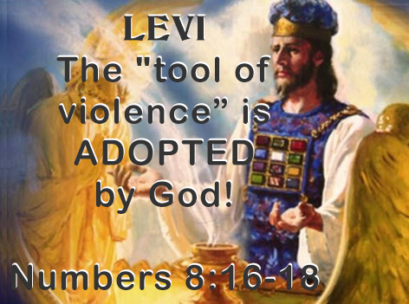
Some Drive-By Snapshots
Chapter 18:a
Verse 7 – Levi’s unique inheritance was better than the other inheritances and was designed to accommodate their ministry. While they received personal land to raise food and cattle, they did not receive an allotment in Israel.
They inherited the offerings. (See Leviticus 1-7)
The Lord Himself was to be their inheritance! (13:33)
The “priesthood of the Lord” was their inheritance. (18:7)
There are many sweet truths for you and me as kingly priests, to apply to our own lives.
The tabernacle has been moved from Gilgal to Shiloh
The remaining seven tribes are
activated.
Levi’s Unique Inheritance
Am I failing to possess what God has for me?

Slide 11
Benjamin
The boundaries are described.
The specific cities are noted.
The distribution is equitable, (according to their families.)
No other special remarks in the passage.
The same spiritual application is here for me:
God has set the boundaries of my spiritual warfare (both in geography and history).
I have a unique area of spiritual responsibility and influence which no one else has.
God allotted to me the unique gifts needed to carry out my unique ministry.

Slide 12
Simeon Genesis 49:5-7
About those matters in our family lines and personal pasts…
Both Simeon and Levi receive less than stellar blessings from Grandpa Jacob.
Levi will later show signs of growth and righteousness as this tribe stands alone and fiercely defends God’s righteousness.
The seeds of anger bear poignant fruit for Simeon.
This is a good time to remember that anger destroys ourselves and our offspring.
It is also a good time to remember that change and growth can occur. Levi overcame her past in spite of her commonality to Simeon.

Slide 13
Zebulun
The boundaries are described.
The specific cities are noted.
The distribution is equitable, (according to their families.)
No other special remarks in the passage.
The same spiritual application is here for me:
God has set the boundaries of my spiritual warfare (both in geography and history).
I have a unique area of spiritual responsibility and influence which no one else has.
God allotted to me the unique gifts needed to carry out my unique ministry.

Slide 14
Issachar
The boundaries are described.
The specific cities are noted.
The distribution is equitable, (according to their families.)
No other special remarks in the passage.
The same spiritual application is here for me:
God has set the boundaries of my spiritual warfare (both in geography and history).
I have a unique area of spiritual responsibility and influence which no one else has.
God allotted to me the unique gifts needed to carry out my unique ministry.

Slide 15
Asher
The boundaries are described.
The specific cities are noted.
The distribution is equitable, (according to their families.)
No other special remarks in the passage.
The same spiritual application is here for me:
God has set the boundaries of my spiritual warfare (both in geography and history).
I have a unique area of spiritual responsibility and influence which no one else has.
God allotted to me the unique gifts needed to carry out my unique ministry.

Slide 16
Naphtali
The boundaries are described.
The specific cities are noted.
The distribution is equitable, (according to their families.)
No other special remarks in the passage.
The same spiritual application is here for me:
God has set the boundaries of my spiritual warfare (both in geography and history).
I have a unique area of spiritual responsibility and influence which no one else has.
God allotted to me the unique gifts needed to carry out my unique ministry.

Slide 17
Dan
The boundaries are described.
The specific cities are noted.
The distribution is equitable, (according to their families.)
No other special remarks in the passage.
The same spiritual application is here for me:
God has set the boundaries of my spiritual warfare (both in geography and history).
I have a unique area of spiritual responsibility and influence which no one else has.
God allotted to me the unique gifts needed to carry out my unique ministry.

Slide 18
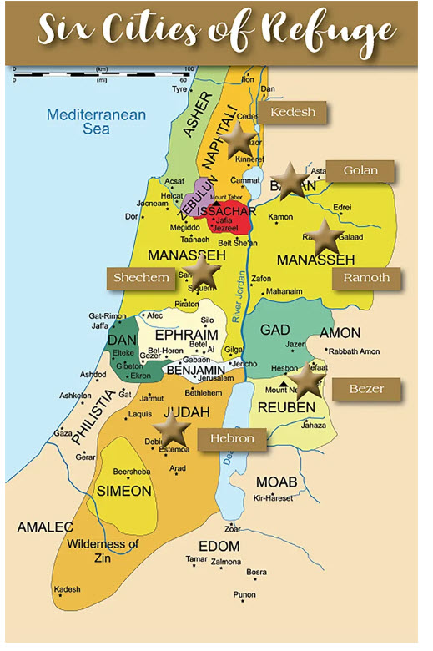
Cities of Refuge Chapter 20
Six Levitical cities were set aside as instructed by Moses.
Three cities were on each side of the Jordan. No one was more than a day’s journey from a city on good roads.
These were not “*sanctuary cities,” as specific rules for effecting justice were enacted.
They provided a safety net to ensure justice, not defeat it, and for the safety of the innocent as Israel transitioned from nomadic law to a landed judicial system.
* Terms such as sanctuary and asylum should be used judiciously when discussing these cities as some modern contexts do not correspond to this provision.
Note: The site that hosts this image, BridgesForPeace is not vetted and may or may not be recommended for purposes other than this paste.

Slide 19
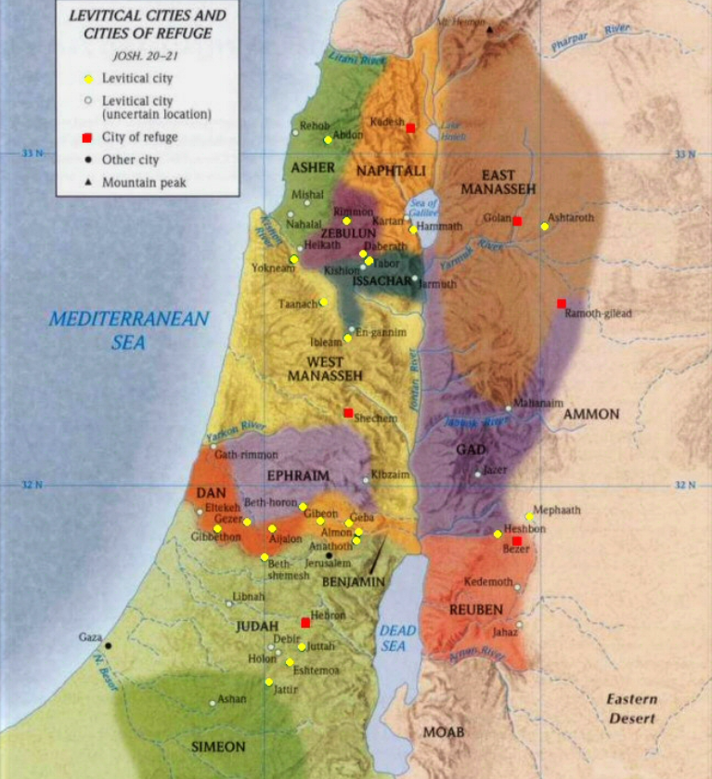
The Levitical Cities Chapter 21
Just as the cities of refuge formed a safety net for justice, the Levitical cities overlaid a spiritual health network on God’s people.
In contrast, we are a kingdom of *priests (or kingly priests). Each believer has been granted full priesthood in and through Christ our Chief priest and mediator. We have been biblically equipped with wonderful, priestly, tools for ministry.
*It is an egregious error to equate modern pastors or elders as priests by virtue of their positions. They are authoritative teachers, and examples given to equip us for our priestly work. However, as our spiritual leaders go, so goes the flock more often than not.
Note: The site that hosts this image, https://www.messianic-torah-truth-seeker.org/ is not vetted and may or may not be recommended for purposes other than this paste.

Slide 20
As we end our tour…take your belongings!
There are battles not yet won, because God wants them to be won in stages: “…by little and little.” Deut. 7:22
Some battles are ongoing because God is still granting grace to the disobedient. Their iniquity is “not yet full.”
Some battles are not won because we are too lazy to claim what is ours. Much of Israel’s failure to conquer can be chalked up to complacency and laziness. “Of all sad words of tongue or pen…”
Some blessings are ours because of our position in God’s family.
Some blessings are ours because we reach out and ask for them.
We are never locked into our destiny. Our spiritual and physical family lines provide wonderful advantages and disappointing disadvantages, but we are never locked into our family history or behavioral traits.

Slide 21
Download our supplemental before they go away!
1. Use your device to scan the QR code above, or
2. Visit StandingTrue.com, select Recent Studies, and select Yah Studies, or
3. Go to: https://www.internetbiblefellowship.com/yah-studies.html

Slide 22
The Flesh Hates Spiritual Quarantine

Slide 23
^{Can you draw} ^{8 analogies…}
Here are eight facts about viruses.
1. Unlike bacteria, viruses are not likely to have been created by God.
2. Unlike bacteria, scientists continually debate whether viruses are dead or alive.
3. Viruses are parasitical. They cannot reproduce on their own.
4. Viruses appear deceptively similar to natural functions.
5. Viruses force the body to do their own bidding.
6. Viruses use human cells to manufacture new copies until the victim is overwhelmed.
7. Viruses mutate, making them difficult targets.
8. Viruses are vulnerable to light.
^{…between}
^{viruses and sin?}
Today With Jim at StandingTrue.com

Slide 24
^{Viruses and sin compared.}
1. Unlike bacteria, viruses are not likely to have been created by God.
“God did not create viruses, since they do not reproduce after their kinds or even clone themselves, like microbes. They are modified genetic material that can capture a cell’s reproductive processes. Thus, it forces it to make copies of itself. Viruses never do good, like the good things God made.” - Victor McAllister
God did not create sin. God is not the author of sin or of confusion of any kind, but He is the author of salvation and forgiveness! Read Hebrews 12:2.

Slide 25
^{Viruses and sin compared.}
2. Unlike bacteria, scientists continually debate whether viruses are dead or alive.
“Nobody’s quite sure if we can label viruses as living. Many scientists struggle with this question.” - Lifeliqe
While we can define sin and even speak of its properties we do not fully understand its exact nature and we certainly cannot see it. Biblical teachers may debate whether it is an entity or not, but we agree it is very much present! Just as the oceans contain at least 200,000 unique viral populations (BBC.com), so sin has infected all of mankind. Just as all men must contend with viruses, all men have been infected with sin
“For all have sinned, and come short of the glory of God” (Romans 3:23).
Sin entered the world through God’s creatures and it is what separates us from our God. In our efforts to quarantine ourselves from viruses we have separated ourselves from each other. As man tries to quarantine himself from sin through good works he only separates himself even more from God. We cannot cure ourselves. We can only make things worse.
“Now to him that worketh is the reward not reckoned of grace, but of debt. But to him that worketh not, but believeth on him that justifieth the ungodly, his faith is counted for righteousness.” - Romans 4:4-5

Slide 26
^{Viruses and sin compared.}
3. Viruses are parasitical. They cannot reproduce on their own.
James says that sin is the result of lust (from the outside) reproducing itself as sin inside the human heart. For a full explanation, read James 1:13-18. Sin cannot reproduce on its own. It requires a host. We sin because we are sinners. We are not innocent victims of sin.
“Then when lust hath conceived, it bringeth forth sin: and sin, when it is finished, bringeth forth death.” - James 1:15

Slide 27
^{Viruses and sin compared.}
4. Viruses appear deceptively similar to natural functions.
“They can be defined as a collection of a few molecules of genetic material, nucleic acid covered by a layer of protein mass to shelter themselves.” - Lifeliqe
When we wash our hands singing Happy Birthday, we are exposing the virus for what it is and destroying its mucous like shield. At that point the body can recognize and destroy it.
When we cleanse our spiritual hands, we can stave off the spawning of sin in our own lives.
“Draw nigh to God, and he will draw nigh to you. Cleanse your hands, ye sinners; and purify your hearts, ye double minded.” - James 4:8
This cleansing is readily available:
“If we confess our sins, he is faithful and just to forgive us our sins, and to cleanse us from all unrighteousness. If we say that we have not sinned, we make him a liar, and his word is not in us.” 1 John 1:9-10.

Slide 28
^{Viruses and sin compared.}
5. Viruses force the body to do their own bidding.
They cannot survive for a long by themselves, therefore they need a host on whom they can ‘parasite’. However, this coexistence is only beneficial for the virus, as it takes over its host and forces him to do his bidding by overwriting its genetic material with its own.” - Lifeliqe
Sin brings bondage and, ironically death.
“For when ye were the servants of sin, ye were free from righteousness…For the wages of sin is death; but the gift of God is eternal life through Jesus Christ our Lord.” - Romans 6:20…23

Slide 29
^{Viruses and sin compared.}
6. Viruses use human cells to manufacture new copies until the victim is overwhelmed.
“Cells become a ‘manufactory’ and create many copies of the original virus, which then inflict other ones and continue until the immune system or drugs slows them down or stops them.” - Lifeliqe
“…Sin, when it is finished, brings forth death.” James 1:15

Slide 30
^{Viruses and sin compared.}
7. Viruses mutate, making them difficult targets.
“Every virus mutates. It is part of the life cycle of the virus.” - Healthline.com
“For such are false apostles, deceitful workers, transforming themselves into the apostles of Christ. And no marvel; for Satan himself is transformed into an angel of light. Therefore it is no great thing if his ministers also be transformed as the ministers of righteousness; whose end shall be according to their works.”
^{- 2 Corinthians 11:13-15}

Slide 31
^{Viruses and sin compared.}
8. Viruses are vulnerable to light.
“As the researchers explained, broad-spectrum UVC light kills viruses and bacteria, and it is currently used to decontaminate surgical equipment. But this type of light can cause skin cancer and cataracts, so it’s not used in public spaces.” - WebMd
“For every one that doeth evil hateth the light, neither cometh to the light, lest his deeds should be reproved. But he that doeth truth cometh to the light, that his deeds may be made manifest, that they are wrought in God.” - John 3:20,21
Conclusion: The struggle with viruses will likely continue and may even be hinted at in the book of Revelation. The solution for sin, on the other hand has been provided and is freely available to all.
“For the wages of sin is death; but the gift of God is eternal life through Jesus Christ our Lord.” - Romans 6:23.
Learn more about the good news of Jesus Christ at StandingTrue.com

Slide 32
Download our supplementals
1. Use your device to scan the QR code above, or
2. Visit StandingTrue.com, select Recent Studies, and select Yah Studies, or
3. Go to: https://www.internetbiblefellowship.com/yah-studies.html

