Slide 1
The cosmic Defeat
of the Amorites
Joshua 10
Science is not the answer!

Slide 2
Our Chapter Breakout
Verses 1-25
A
^{A. The Enemy Assembles 1- 5}
^{B. The Gibeonites Appeal 6}
^{C. Joshua Ascends 7}
^{D. The Lord Assures 8}
^{E. The Battle Approaches 9}
^{F. The Lord Attacks 10-11}
^{G. Joshua Appropriates 12-14}
^{H. The Kings Evacuate 15-21}
I. The Elders Participate 22-25
H
B
G
I
C
F
D
E

Slide 3
The Enemy Assembles 1-5
Verses 1-25
Intro: Life is complicated. We all do foolish things and must make lifetime adjustments for earlier errors. God does not let us navigate alone.
Regarding Gibeon: The children of this world are often wiser. Luke 16:8. See Mat. 5:25, Lk 14:31-32.
Some see Adoni-zedek (Lord of Righteousness) as an antitype of antichrist. Notice that his “spin” makes his cause sound righteous! In any case, notice that he is king of Jerusalem.
This recalls a former king of Jerusalem named Melchi-zedek (King of Righteousness.)
In any case, Satan has assembled his hosts against us as surely as Adonizedek assembled his.
A
^{A. The Enemy Assembles 1- 5}
^{B. The Gibeonites Appeal 6}
^{C. Joshua Ascends 7}
^{D. The Lord Assures 8}
^{E. The Battle Approaches 9}
^{F. The Lord Attacks 10-11}
^{G. Joshua Appropriates 12-14}
^{H. The Kings Evacuate 15-21}
I. The Elders Participate 22-25

Slide 4
The Gibeonites Appeal 6
Verses 1-25
We cannot change the past and we should go the extra mile to maintain our present integrity. This teacher has seen many folks who have honored their obligations even though they had been defrauded or taken advantage of.
Even so, there is a larger lesson. Alliances can be very dangerous things. We must never mutually obligate ourselves to others with about absolute confidence that God is in it. He has never looked lightly on alliances of any form. Can you think of any place in scripture where God approves an alliance?
^{A. The Enemy Assembles 1- 5}
^{B. The Gibeonites Appeal 6}
^{C. Joshua Ascends 7}
^{D. The Lord Assures 8}
^{E. The Battle Approaches 9}
^{F. The Lord Attacks 10-11}
^{G. Joshua Appropriates 12-14}
^{H. The Kings Evacuate 15-21}
I. The Elders Participate 22-25
B

Slide 5
Joshua Ascends 7
The big picture: The Lord is gracious and slow to anger. He waited four generations to fulfil His promise to Abraham (Genesis 15:16). Joshua was now obeying a specific commandment given by God through Moses.
“Though the mills of God grind slowly; Yet they grind exceeding small; Though with patience He stands waiting, With exactness grinds He all.” George Herbert - 1652
Joshua is doing more than just keeping his word to Gibeon. He is obeying God’s direct command and claiming His promise.
Some older folks have noticed how glib younger generations can be when speaking about the great depression. Recent events have added a new sobriety to this discussion. In the same way, we can be glib when we picture Joshua running off to battle. This was a major encounter which would have petrified any of us.
Verses 1-25
^{A. The Enemy Assembles 1- 5}
^{B. The Gibeonites Appeal 6}
^{C. Joshua Ascends 7}
^{D. The Lord Assures 8}
^{E. The Battle Approaches 9}
^{F. The Lord Attacks 10-11}
^{G. Joshua Appropriates 12-14}
^{H. The Kings Evacuate 15-21}
I. The Elders Participate 22-25
C

Slide 6
The Lord Assures 8
Verses 1-25
We too have been blessed with all spiritual blessings in HEAVENLY places - Ephesians 1:3.
God always sees the victory as already won - and He expects us to do the same. Sin: We reckon ourselves dead unto sin and alive unto God. We ARE more than conquerors through Him that loves us!
^{A. The Enemy Assembles 1- 5}
^{B. The Gibeonites Appeal 6}
^{C. Joshua Ascends 7}
^{D. The Lord Assures 8}
^{E. The Battle Approaches 9}
^{F. The Lord Attacks 10-11}
^{G. Joshua Appropriates 12-14}
^{H. The Kings Evacuate 15-21}
I. The Elders Participate 22-25
D

Slide 7
The Battle Approaches 9
Verses 1-25
Notice the perfect compatibility of the sovereignty of God “I have delivered them” and our responsibility “Joshua came up unto them suddenly.”
Consider our present circumstance. There are those who expose themselves blindly assuming God will protect. There are those who are neutralized by fear. Neither are wise.
Remember the P’s (not necessarily in any order) of good success:
1. Promise
2. Prayer
3. Plan
4. Perform
5. Praise
^{A. The Enemy Assembles 1- 5}
^{B. The Gibeonites Appeal 6}
^{C. Joshua Ascends 7}
^{D. The Lord Assures 8}
^{E. The Battle Approaches 9}
^{F. The Lord Attacks 10-11}
^{G. Joshua Appropriates 12-14}
^{H. The Kings Evacuate 15-21}
I. The Elders Participate 22-25
E

Slide 8
END OF SESSION 1
Visit Jim at StandingTrue.com

Slide 9
Week TWO – YAH 5/3/20
Our Chapter Breakout – We left off around point F.
Verses 1-25
A
^{A. The Enemy Assembles 1- 5}
^{B. The Gibeonites Appeal 6}
^{C. Joshua Ascends 7}
^{D. The Lord Assures 8}
^{E. The Battle Approaches 9}
^{F. The Lord Attacks 10-11}
^{G. Joshua Appropriates 12-14}
^{H. The Kings Evacuate 15-21}
I. The Elders Participate 22-25
H
B
G
I
C
F
D
E

Slide 10
Red = Southern Campaign
Joshua 10
Green = Initial Central Campaign featuring Jericho and Ai in Joshua 6 and 8

Slide 11
10:7 So Joshua ascended from Gilgal, he, and all the people of war with him, and all the mighty men of valour.

Slide 12
9a Joshua therefore came unto them suddenly, and went up from Gilgal all night. 10 And the LORD discomfited them before Israel, and slew them with a great slaughter at Gibeon…

Slide 13
9b …and chased them along the way that goeth up to Bethhoron, and smote them to Azekah, and unto Makkedah.

Slide 14
The Lord Attacks 10-11
Verses 1-25
I would like to remind you that this God we serve is the Lord of both HEAVEN and EARTH. God is going to rain down from HEAVEN on nations who served their provincial, earthly gods. They had no divine program, no explanations for the events of history or grand scheme.
It is the consensus that both Jehovah God and Joshua are mocking these elohim - whose favorite objects of worship were the sun and moon and stars!
Remember how God mocked the gods of Egypt in the 10 plagues. Recently, I hear our local rabbi say “God is not in the plague. He is in our response to the plague.” Wow, man, that’s heavy! It’s also wrong. God uses both sunshine and rain to effect His ultimate and grand purpose, and He does so with love and compassion.
^{A. The Enemy Assembles 1- 5}
^{B. The Gibeonites Appeal 6}
^{C. Joshua Ascends 7}
^{D. The Lord Assures 8}
^{E. The Battle Approaches 9}
^{F. The Lord Attacks 10-11}
^{G. Joshua Appropriates 12-14}
^{H. The Kings Evacuate 15-21}
I. The Elders Participate 22-25
F

Slide 15
Joshua Appropriates 12-14
Verses 1-25
Joshua was not impulsive when he commanded the heavenly orbs to fall in line with God’s battle plan. Neither was he presumptuous. But I’ll coin a phrase for the occasion. I believe Joshua was “assumptuous.” He simply believed that this was both fitting and appropriate - and it was no big deal for our God to accomplish!
In contrast to Joshua’s childlike “assumptuous” faith we have endured the speculations of tens of thousands of God’s children who have exposed their own incredulity when it comes to this passage. WE DON’T REALLY CARE HOW GOD DID IT! It’s no big deal!
HAVING SAID THAT, We still need to protect ourselves from falling into some of the traps by considering a thing or two that the Bible does make clear.
^{A. The Enemy Assembles 1- 5}
^{B. The Gibeonites Appeal 6}
^{C. Joshua Ascends 7}
^{D. The Lord Assures 8}
^{E. The Battle Approaches 9}
^{F. The Lord Attacks 10-11}
^{G. Joshua Appropriates 12-14}
^{H. The Kings Evacuate 15-21}
I. The Elders Participate 22-25
G

Slide 16
A
B
JESUS CHRIST
IS OUR
CONSTANT
JESUS CHRIST SUSTAINS AND CARRIES HEAVEN AND EARTH FORWARD THROUGH THE FATHER’S DECREES AND ORDINANCES ACCORDING TO HIS WILL.
Colossians 1:16-17, Hebrews 1:3.
*(Consist= sunistao, Upholding= phero ~ carry forward.)
HEAVEN AND EARTH FULFILL THE WORD OF GOD.
GOD COMMANDED AND HEAVEN AND EARTH WERE CREATED – PSALM 148:5-7

Slide 17
Continued discussion - 1.
Joshua Appropriates 12-14
A good place to look is Psalm 148 where the Lord God draws the lines makes it clear that both HEAVEN and EARTH are under His dominion - right now! He is not waiting for us to reclaim them for Him through love, as some dominionists are declaring today.
- God commanded and they were created - Verse 5.
- HE RULES the creation itself and all living things by His decrees and ordinances - Verse 6,
- And, all of the manifestations which we see from what we call astro mechanics, down to the minutest nano mechanics, yes, even viruses, fulfill His Word - Verse 7.
.

Slide 18
Continued discussion - 2.
Joshua Appropriates 12-14
If one accepts what has been taught by science around him, he believes in the laws of nature.
When we speak of those laws, we are by default saying that nature governs itself. Nature does not have a single law inherent in it. Jesus Christ is carrying forward all these decrees (which we may just as easily call processes or ordinances) and He executes them on an ongoing basis, in perpetuity.
He is not beholden to those processes or decrees; they are beholden to Him. He can interrupt, speed up, slow down, any object or process as He jolly well pleases, and He can do so independently from all of the other processes which are interdependent upon each other. He doesn’t need the gas pedal, He can throttle the engine under the hood at any time.

Slide 19
Continued discussion - 3.
Joshua Appropriates 12-14
One who believes Jesus Christ is carrying the creation forward interactively at His will and under the direction of His Father, miracles should not be amazed. Miracles should amaze unbelievers, but we should never be amazed in the sense that the world is.
Nail down the point: This universe is neither self-creating nor self-governing nor self-perpetuating or self-expanding or anything else! It fulfills the word of the living God. You cannot even text and drive at the same time. Your Lord Jesus texts and drives simultaneously.

Slide 20
We now begin this week’s study: The Kings Evacuate 15-21
Verses 1-25
When these kings separated off and hid themselves, Satan may have been offering a shortcut to Israel. The temptation was there to quit, or at least, to shift their focus, before the job was done. It would have been appropriate to celebrate victory over these kings prematurely. Instead, Israel completed her task. She did what had to be done and it was not a pretty task.
Do what you’ve been called to do. An unfinished task is no victory at all. Do God’s will. Do it thoroughly. Do it completely. The day of rejoicing will come in God’s time.
^{A. The Enemy Assembles 1- 5}
^{B. The Gibeonites Appeal 6}
^{C. Joshua Ascends 7}
^{D. The Lord Assures 8}
^{E. The Battle Approaches 9}
^{F. The Lord Attacks 10-11}
^{G. Joshua Appropriates 12-14}
^{H. The Kings Evacuate 15-21}
I. The Elders Participate 22-25
H

Slide 21
The Elders Participate 22-25
Verses 1-25
1. He was sending a message of impunity to the enemy.
2. He was sending a message of unity to Israel. They were all in this together.
I believe God was also sending a message of obedience to us! We live in a super sweet, soppy, flabby culture.
Its time to stand up and say, Yes! God does judge sin. He is infinitely patient. This may not be our time, but then again it may! In any case, an ark is being built before the eyes of the world! Board by board it is being assembled and pitch is being applied.
^{A. The Enemy Assembles 1- 5}
^{B. The Gibeonites Appeal 6}
^{C. Joshua Ascends 7}
^{D. The Lord Assures 8}
^{E. The Battle Approaches 9}
^{F. The Lord Attacks 10-11}
^{G. Joshua Appropriates 12-14}
^{H. The Kings Evacuate 15-21}
I. The Elders Participate 22-25
I

Slide 22
The Campaign Consummated
Scan verses 26-43 as we point out the highlights.

Slide 23
29 Then Joshua passed from Makkedah, and all Israel with him, unto Libnah, and fought against Libnah: 30 And the LORD delivered it also…

Slide 24
31 And Joshua passed from Libnah, and all Israel with him, unto Lachish, and encamped against it, and fought against it: 32 And the LORD delivered Lachish into the hand of Israel…

Slide 25
33 Then Horam king of Gezer came up to help Lachish; and Joshua smote him and his people, until he had left him none remaining.

Slide 26
34, 35a And from Lachish Joshua passed unto Eglon, and all Israel with him; and they encamped against it, and fought against it: And they took it on that day…

Slide 27
36 And Joshua went up from Eglon, and all Israel with him, unto Hebron; and they fought against it:

Slide 28
38 And Joshua returned, and all Israel with him, to Debir; and fought against it:

Slide 29
41 And Joshua smote them from Kadeshbarnea even unto Gaza, and all the country of Goshen, even unto Gibeon.

Slide 30
42 And all these kings and their land did Joshua take at one time, because the LORD God of Israel fought for Israel. 43 And Joshua returned, and all Israel with him, unto the camp to Gilgal.

Slide 31
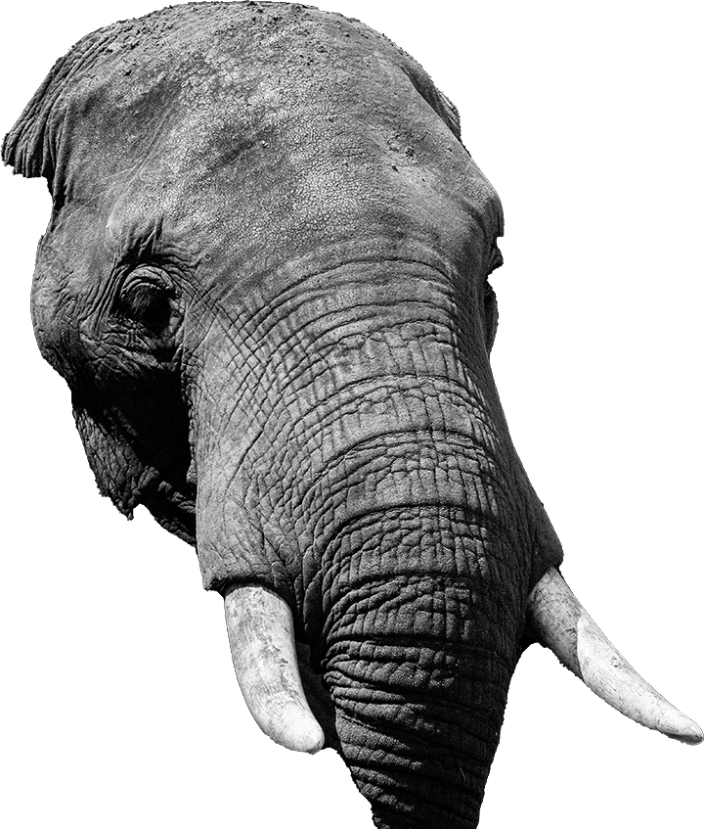
Now, about that animal in the room.
In each case, the Lord God fought for Israel even before Israel fought for Him.
Each city in the southern incursion was destroyed in the same manner as the previous.
The king of each city was destroyed.
Everything that breathed within each city was destroyed.

Slide 32
Was this Genocide?
This was genocide if we use the U.N. definition which suggests any killing of people in any common group.
This was not genocide if, by that term, we suggest in any way that this was racially or ethnically motivated.
The inhabitants of this land were from mixed ethnic origins.
God loves every kindred, tongue, and nation and is unwilling that any should perish.
Some entire people groups have, however, aligned themselves against God.

Slide 33
Note the ethnic composition of Canaan and the surrounding area. It is good to avoid calling this area Palestine.
Note: The site that hosts this image is not recommended for doctrinal or theological sourcing.

Slide 34
We must not charge God foolishly.
God both gives and takes away human life. (Job 1:20-21)
God has judged in the past and promises do it again. (2 Peter 3:9-10)
God does not destroy arbitrarily at a whim. (Matthew 10:28-29)
- When God takes life it is for the benefit of mankind. (Romans 9:22-24
- The Canaanites, for example were destroyed because their iniquity was full, not because God wanted their land. (Genesis 15:16)

Slide 35
God Knows the End from the Beginning
God, in His wisdom, destroys groups of people:
- He accelerates consequences that are already in play. (James 1:14,15).
- He protects future generations.
- He executes justice for clearly stated reasons (Genesis 6:13.)
- He does so with clearly stated warnings (Genesis 9:3-6)

Slide 36
God does not play by our rules.
When men accuse God of injustice:
- We turn a blind eye to our own allegiances. Notice how false religion is always given a pass on the issue of sin.
We claim “free agency” and then blame God for the consequence.
- Without exception, we fail to see the insidious nature of sin. (By His mercy we are not all consumed) – Lam. 3:22)

Slide 37
The Lord is not slack concerning his promise, as some men count slackness; but is longsuffering to us-ward, not willing that any should perish, but that all should come to repentance. 10 But the day of the Lord will come as a thief in the night; in the which the heavens shall pass away with a great noise, and the elements shall melt with fervent heat, the earth also and the works that are therein shall be burned up,
1 Peter 3:9,10

Slide 38
We have found the elephant, and it is us.
When confronting this issue remember that self-justifying men will try to impose their flawed moral compass on God. (Rom. 9:20)
- Use the scriptures lovingly, but boldly. (2 Tim. 2:24)
Do not apologize for God or mitigate what He has said or done. God is righteous, and He is not embarrassed by His actions. Matt. 10:34-36)
God loves the world and did not send His Son to condemn it – but to redeem it. (John 3).

Slide 39
END OF SESSION 2 – JOSHUA 10b
Download these materials from our Recent Studies page at StandingTrue.com

